Slide 1




Python: From the perspective of an Applied Mathematician
Presented by- Indranil Ghosh
Website- indrag49.github.io
@indraghosh314

Slide 2

Career Trajectory
B.Sc. (Physics)
M.Sc. (Physics)
Data Science (Sirpi.io)
Ph.D. (Applied Mathematics)

Slide 3
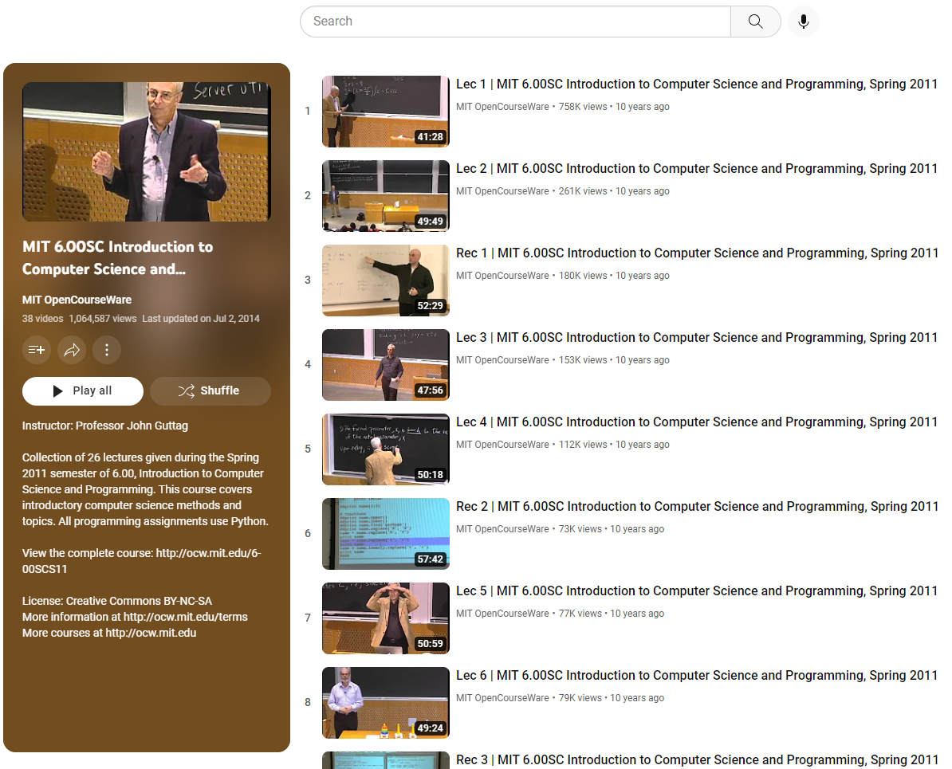
Prof. John Guttag's lecture series in Computer Science and Programming using Python.
Link: https://www.youtube.com/playlist?list=PLB2BE3D6CA77BB8F7

Slide 4
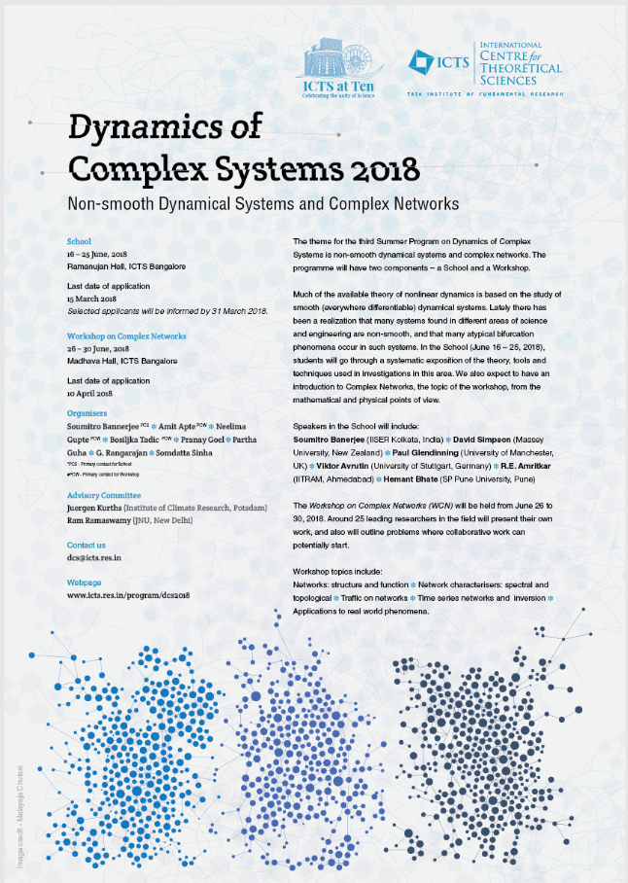

Slide 5
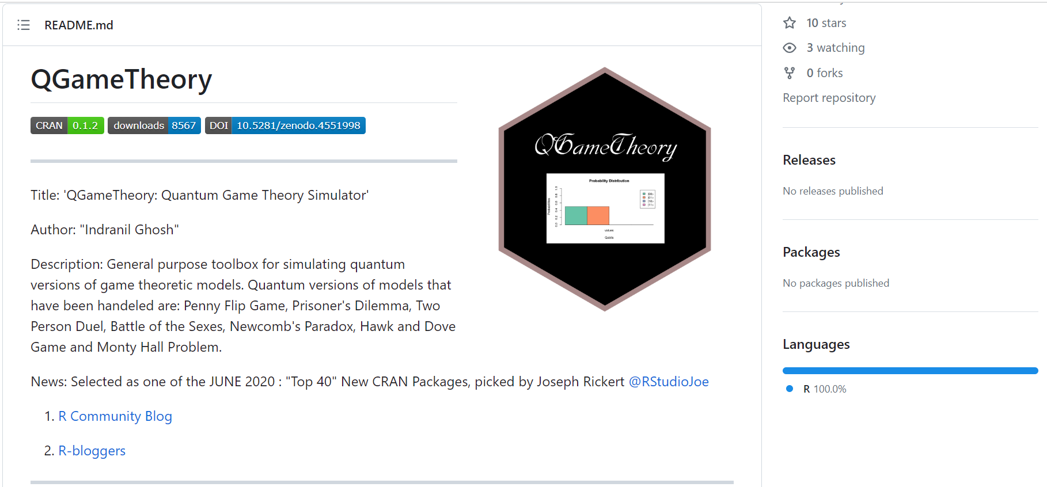

Slide 6
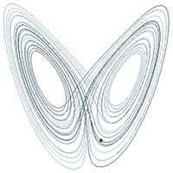
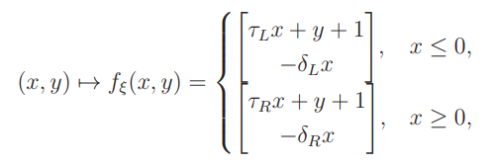

What's my job?
Chaos Theory
Source: Wikipedia

Slide 7
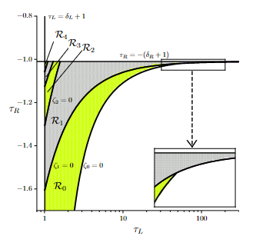
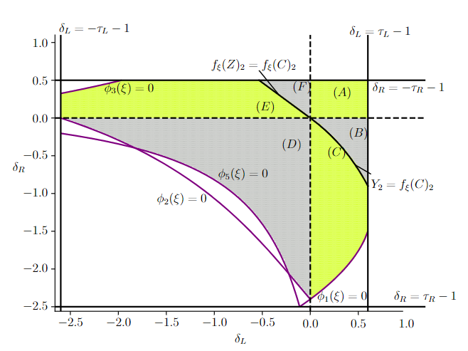
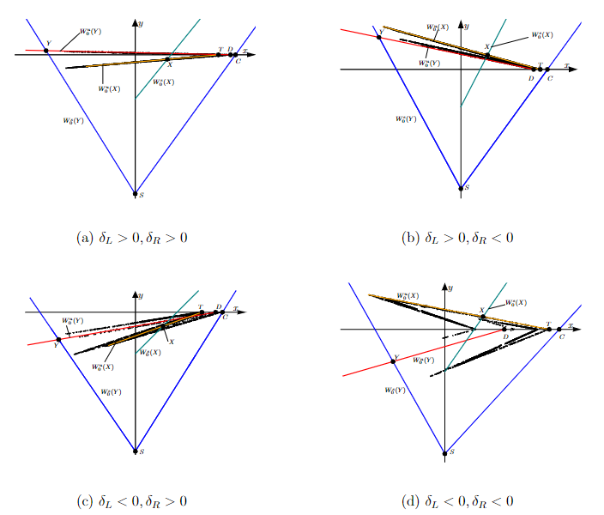





What's my job?
Research on switched-dynamical systems and chaos (Ph.D. project funded by Royal Society of New Zealand).
Indranil Ghosh and David J. W. Simpson, "Renormalisation of the two-dimensional border-collision normal form" in Int. J. Bifurcation Chaos 32(12):2250181, 2022
Indranil Ghosh and David J. W. Simpson, "Robust Devaney chaos in the two-dimensional border-collision normal form." in Chaos 32:043120, 2022.

Slide 8
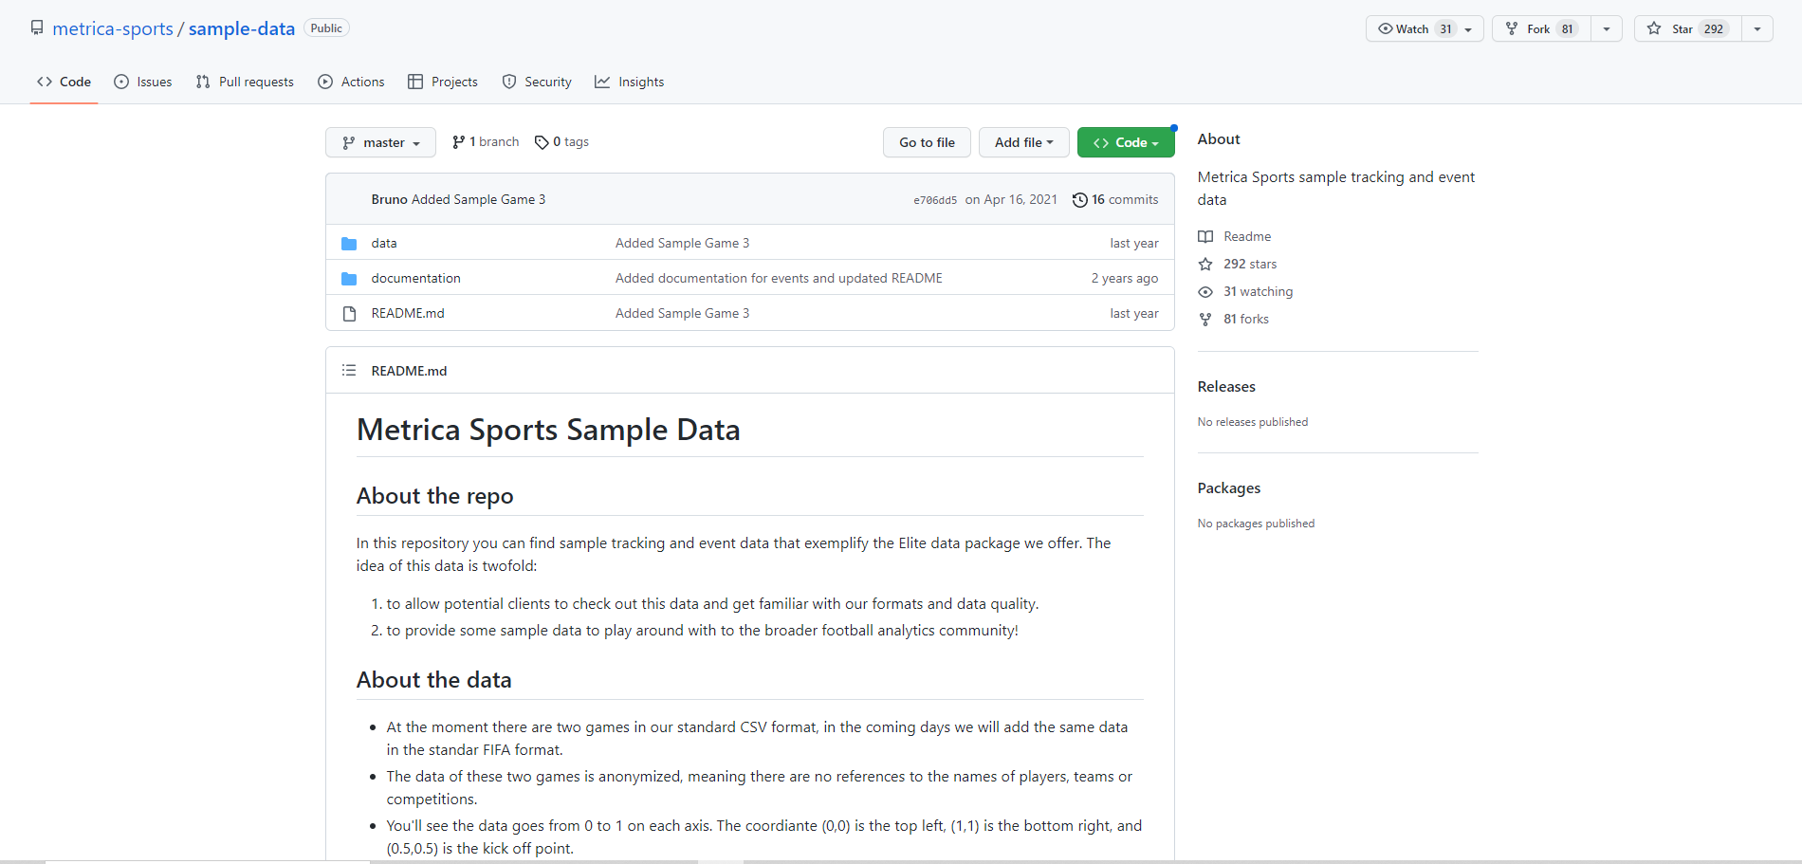
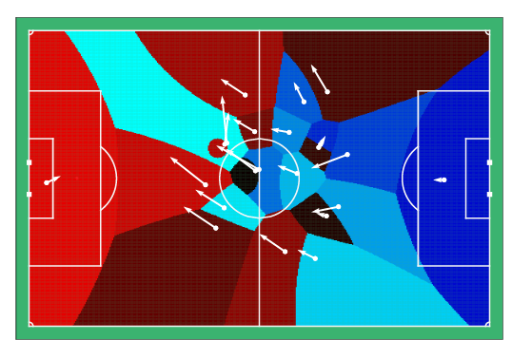
Toy projects over the years
1. Soccer analysis.
Costas J. Efthimiou, Gregory DeCamillis, and Indranil Ghosh, "A physics-driven study of dominance space in soccer". {Preprint}

Slide 9
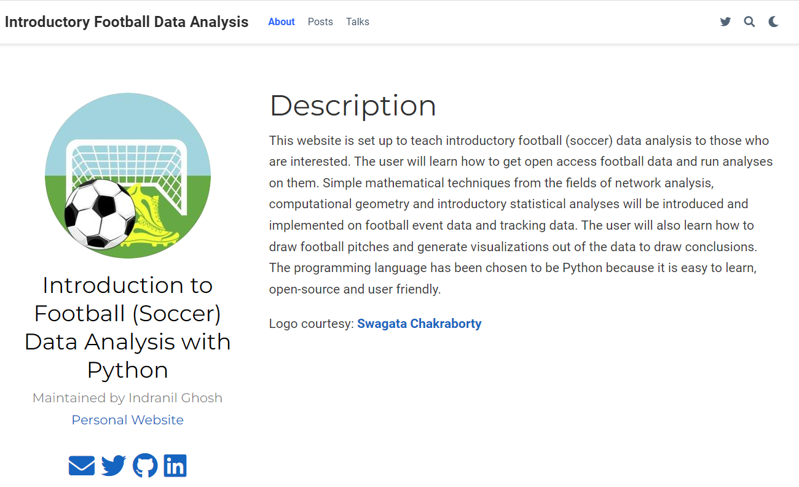

Slide 10
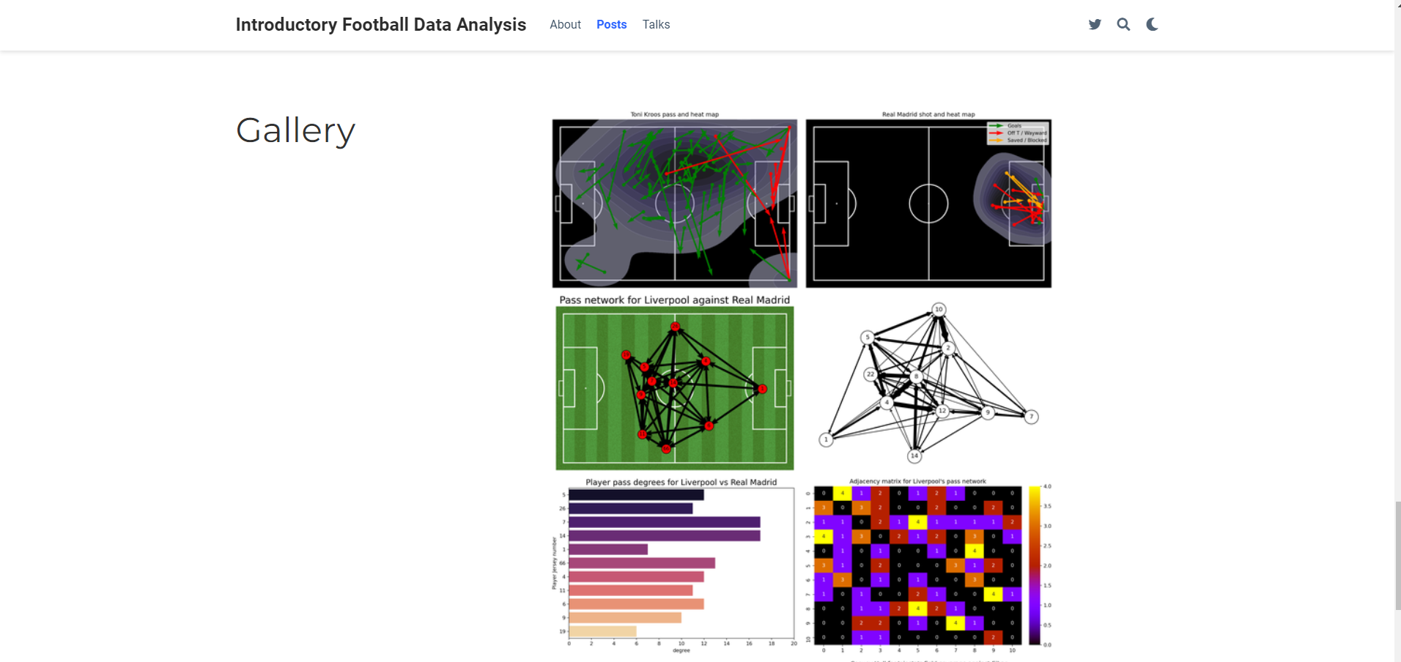

Slide 11
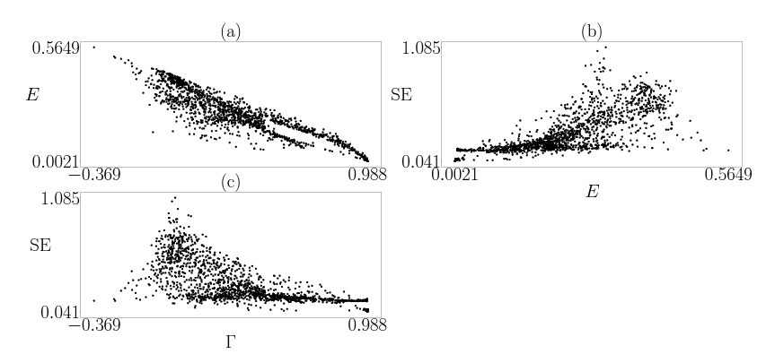
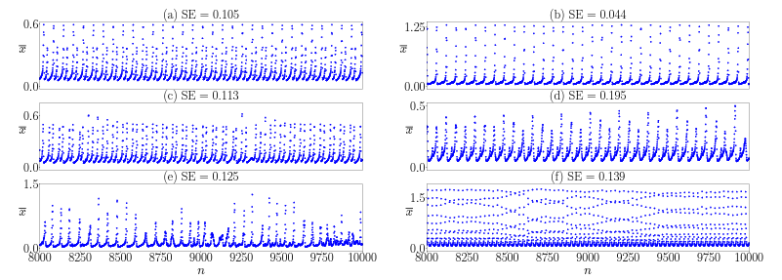
Toy projects over the years
2. Neurodynamics.
Sishu Shankar Muni, Hammed Olawale Fatoyinbo, and Indranil Ghosh, "Dynamical effects of electromagnetic flux on Chialvo neuron map: nodal and network behaviors" in Int. J. Bifurcation Chaos 32(09):2230020, 2022 .
Hammed Olawale Fatoyinbo, Sishu Shankar Muni, Indranil Ghosh, Ibrahim Olatunji Sarumi, Afeez Abidemi, "Numerical bifurcation analysis of improved denatured Morris-Lecar neuron model," in the proceedings of the 2022 International Conference on Decision Aid Sciences and Applications (DASA).
Indranil Ghosh, Sishu Shankar Muni, and Hammed Olawale Fatoyinbo, "On the analysis of a heterogeneous coupled network of memristive Chialvo neurons“ in Nonlinear Dyn., 111:17499–17518, 2023.

Slide 12
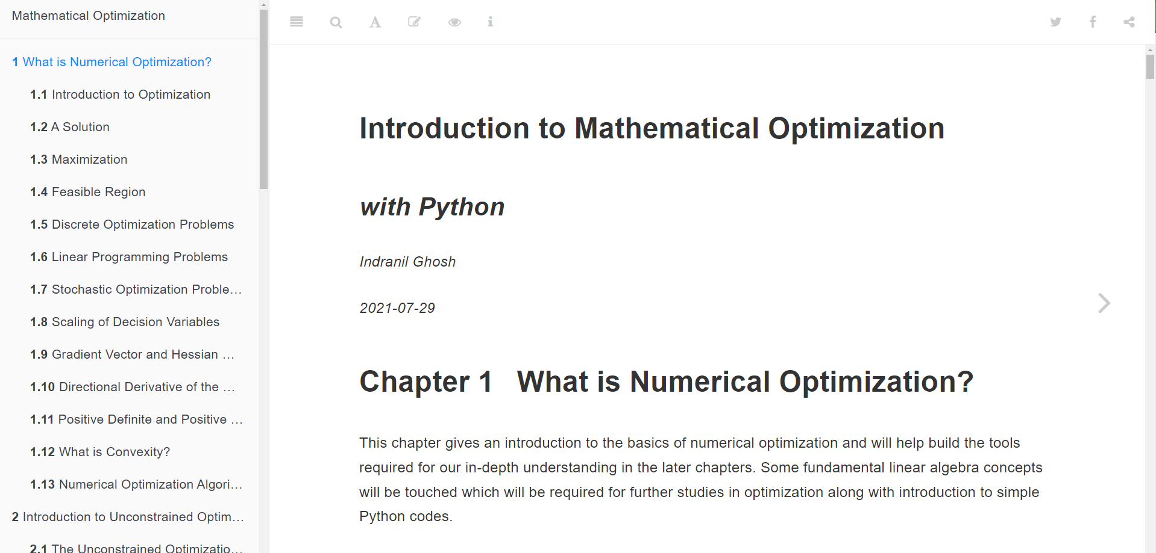

Slide 13
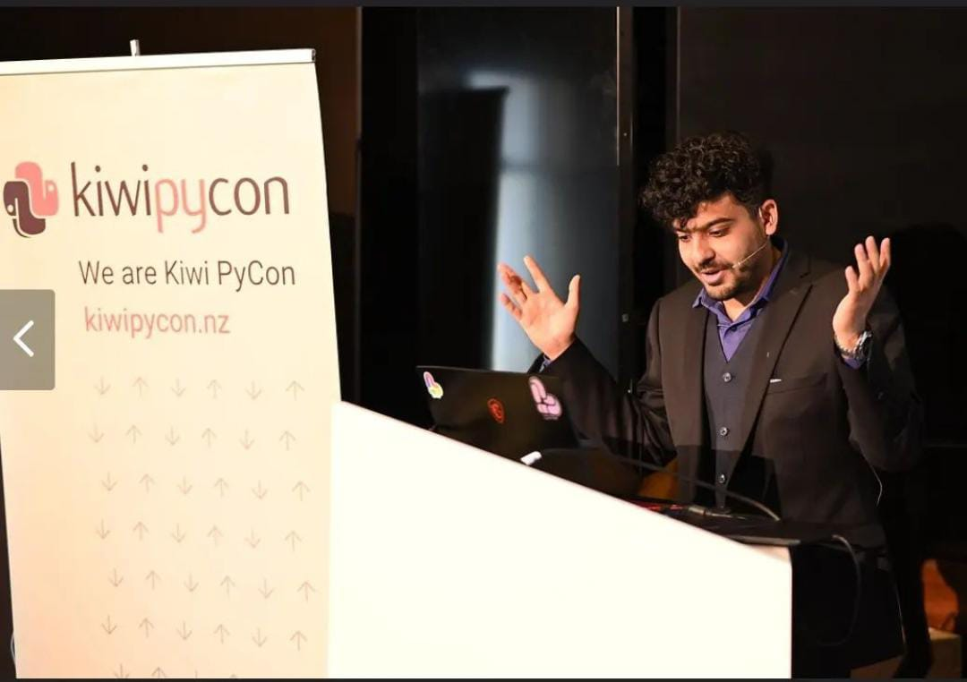

My first in-person PyCon: Kiwi Pycon
This Photo by Unknown author is licensed under CC BY-NC.
Photo credit: Kristina D.C. Hoeppner

